Slide 1

FITSUM
ONE STOP DESTINATION WHERE YOU CAN COMMIT TO A NEW YOU

Slide 2
PROJECT
SEMESTER: 2( 1st year)
SUBJECT CODE: AIP-102
BRANCH: BE-CSE(AI)
CREDITS: VANSHITA KAPOOR
ROLL NUMBER: 2110993882
GROUP NUMBER: G-02
SUBMITTED TO: Dr. Vandana Sood

Slide 3
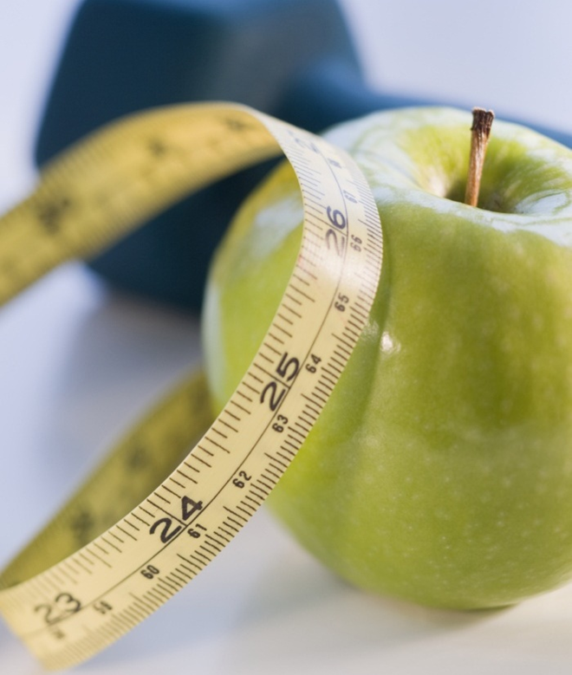
OBJECTIVE
The objective of a fitness website is to provide the user with instructions and examples of one or more types of exercise, physical activity, nutritional programs, or some other fitness topic at the convenience of just one click.
It is used to count calories, provide a workout guide and also calculates the Body Mass Index of the user to keep a track of their performance.
It is basically designed to connect the user to a platform in order to help with areas of concerns when using a specific fitness routine or just generally with workouts.
Those people who are mostly indulged in internet and don’t get time to look after their health can invest more time upon their health through this.

Slide 4



An all-in-one website
Here, you get BMI Calculator, Calorie Tracker and a Workout Guide

Slide 5

Introduction
Fitness websites are like a one-stop station where you can monitor all your lifestyle parameters like calorie count, diet, body mass index(BMI) and workout guide and routine.
An All In One Health Tool: You don't need to maintain different diaries or books to keep a record of all these things.
BMI Calculator & Calorie Tracker are basically designed using Jquery selectors.
Keeps You Motivated: One of the most important benefits of using a fitness app is 'motivation’. Since it is available at the convenience of your phones, it keeps reminding you about your health goals, thus keeping you motivated.

Slide 6
Workout Guide
BMI Calculator
Calorie Counter
Flowchart
The user will get a log in and sign up through which they can easily access webpage.
The user can surf the webpage and can even go to a particular section
User can keep a check of health & fitness at their fingertips
User gets links of youtube videos as a workout guide and a calorie tracker where you can keep a track of calories consumed

Slide 7
Advantages
Easily keeps track of your progress.
When you begin exercising, you must set realistic goals and this website helps you achieve those goals.
You can carry your dietitian in your pocket now.
You can monitor your Diet Every Day.
The website can monitor your calories and the intake of nutrients on the basis of the food intake throughout the week.
The user can get access to some free youtube videos for workout which might be a tedious task for some to search and look for the good videos.

Slide 8

HTML
CSS
JAVASCRIPT
Technology Used
BOOTSTRAP

Slide 9
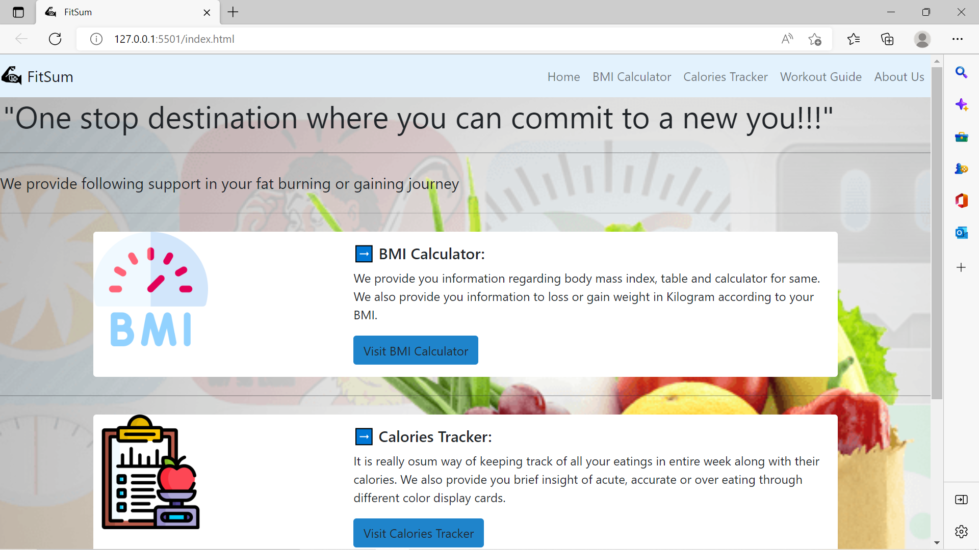
Home Page of the website

Slide 10
Components
Calorie tracker
Workout Guide
BMI Calculator
Calorie trackers are extremely useful if you are trying to lose, maintain or even gain weight and helps you make specific changes to your diet.
Exercise is good for you, but getting started can be tough for many.So it provides you reference to some best and effective workout videos.
It is a measure of body fat based on height and weight of a person and categorizes BMI bsed on providation information from WHO

Slide 11

Conclusion
In my project an attempt has been made to develop a health or fitness based website. I developed this project that helps people to be aware about their health. To establish website I have used various technologies. It is going to be of a great use especially for this generation who loves to get anything with just one click or getting the work done at their own comfort level. Users can surf the website and keep a check on their health & fitness at their own comfort place doesn’t matter where they are at their current location. Hence, it will be of a great use for almost everyone irrespective of its age group.

Slide 12
THANK YOU

